Slide 1
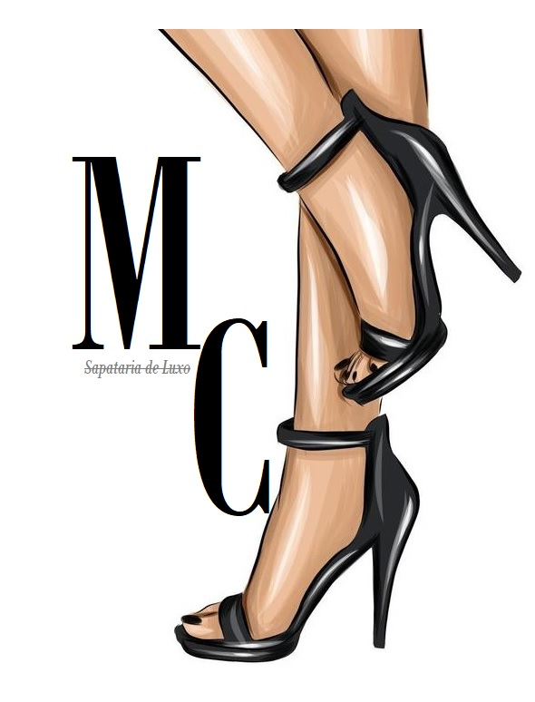
Master Choose
More quality instead of more quantity

Slide 2
Our company
Master Choose is a company committed to producing footwear with social responsibility and environmental management, under 3 pillars: comfort, modern design and sustainability, in the market since 1981.
Our luxury shoes are all made in the best Portuguese factories, with the best materials.
Our company wants to be recognized as a company committed to sustainable development, which values ​​quality over quantity.

Slide 3
Awards
Best luxury shoes 2018 and 2019.
Best Portuguese super brand 2020 and 2021.

Slide 4
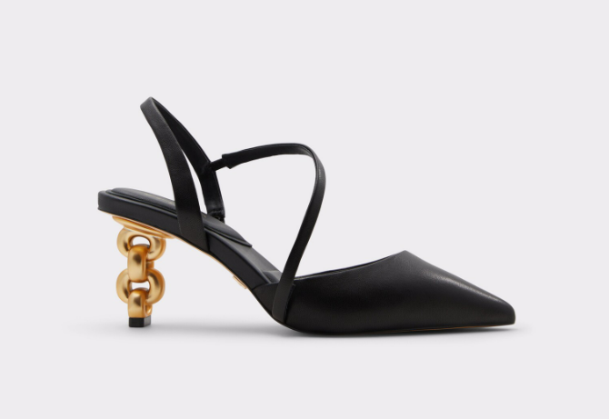
Spring Collection
Model- “O Básico Preto”
“The Basic Black”

Slide 5
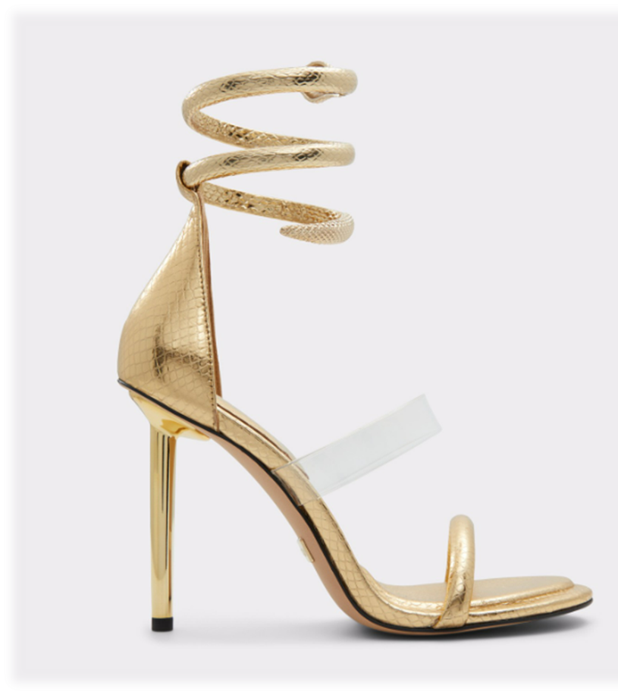
Spring Collection
Model- “A Medusa Dourada”
“The Golden Medusa”

Slide 6
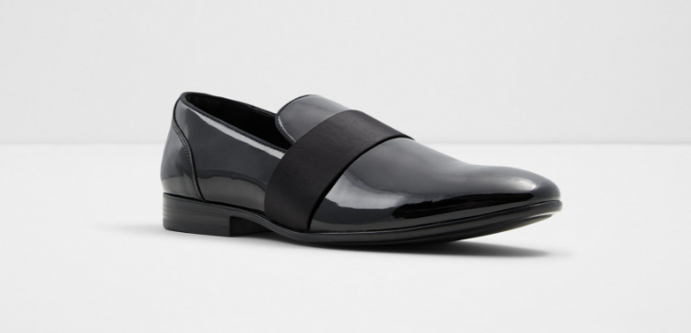
Spring Collection
Model- “O Verniz Preto”
“The Black Varnish”

Slide 7
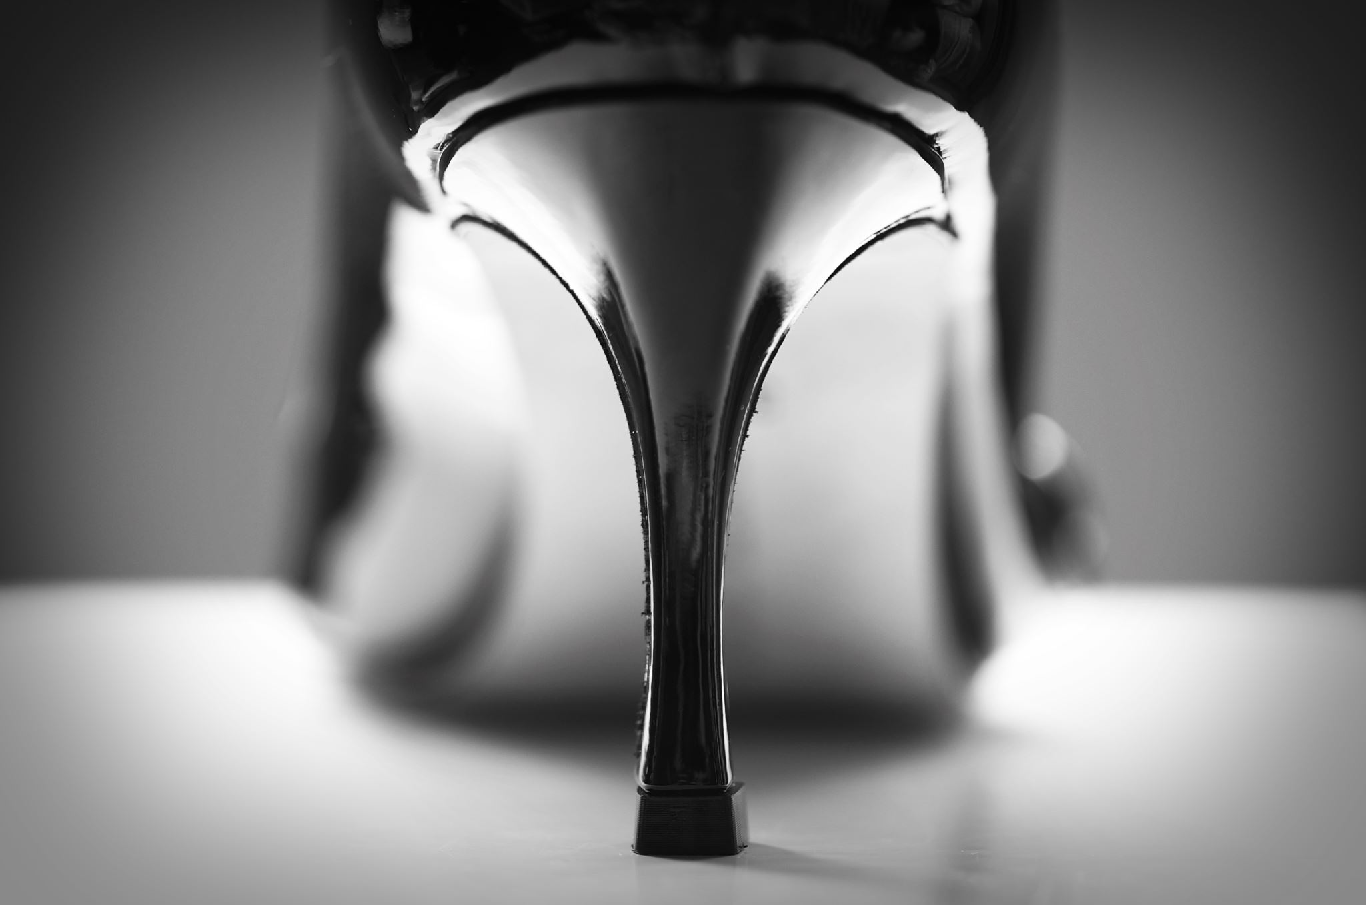
Together we will take the footwear market to anther level!
Thank You

